Slide 1
Stock trading optimization using DQN
Agnibh Dasgupta

Slide 2
Method- DQN
State space(initial) – [Adjusted close, number of holdings of stock]
Adjusted close to be changed to moving average.
Action space – [Buy, Hold, Sell]
Initially takes random actions to learn
Eventually takes greedy
Reward = Difference in (price*holdings)
Use a NN to approximate Q values based on state-action pairs
3 layer NN:
Dimensions -> State space(3) : 64 : 32 : 8 : Action space (3)

Slide 3
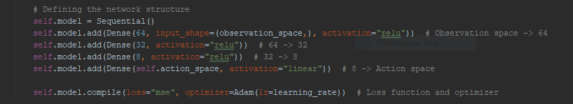
Network:

Slide 4
Parameters:
Discount factor = 0.95
Initial learning rate = 0.001
Initial exploration rate = 1 (decaying upto a min of 0.1)

Slide 5
Experience Replay and Batch Sampling
‘Remembers’ experiences while trading in the form of:
[state, action, reward, next_state]
Has an upper limit, forgets older memories as it gets new ones.
Randomly samples a batch within the memory.
Computes Q values and fits model.

Slide 6
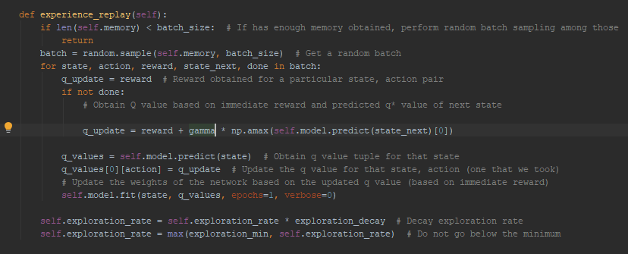

Slide 7
Training and Testing data
I’m using a single file training and testing for the results that I have.
Since the exploration rate decays, it acts as a pseudo test data.

Slide 8
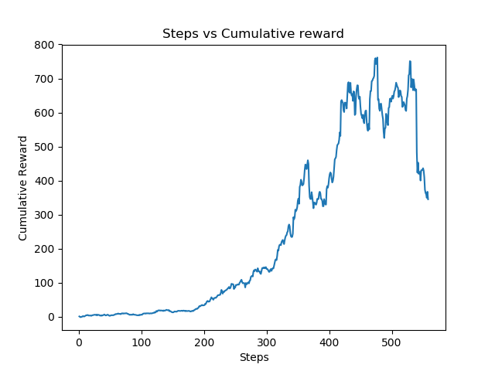
Results so far:

Slide 9
Stuff to do
Immediate:
Increase sample space from Adjusted Close to more representative parameters. (Moving Average? Image of the stock?)
Impose limitations on holdings?
Change the reward structure?
Later:
Expand to multiple stocks.
Test on live data.

Slide 10
Schedule
In next week, I plan to:
Expand sample state (exploring image of the stock data as part of the sample space)
Finalize the algorithm for a single stock (holdings, reward structure)

Slide 11
Thanks!

